Slide 1
Financial Services Introduction
朱一鸣
2011年

Slide 2
Recommended Books
说谎者的扑克牌
贼巢
门外的野蛮人
泥鸽靶
对冲基金风云录
史上最伟大的交易
Foundations of Financial Markets and Institutions

Slide 3
Financial Business Structure
Financial Assets
Financial Market
Financial Institutions /Intermediaries

Slide 4
Financial Assets or Instruments
Bond
Stock
Option
Future
Foreign Exchange
Swap

Slide 5
Financial Markets
Classify by nature of claim
Debt Market
Stock Market
Classify by maturity of claim
Money Market
Capital Market
Classify by Seasoning of claim
Primary Market
Secondary Market
Classify by immediate delivery or future delivery
Cash or spot Market
Derivative Market

Slide 6
Financial Intermediaries
Buy side and Sell side
Sell Side indicates a firm that sells investment services to asset management firms.
Sell side normally create a product and then sold in the market.
Sell side entities: investment Bank, Broker/Dealer.
Buy Side will buy the services or products.
Buy Side entities: Private equity funds, mutual funds, unit trusts, hedge funds, pension funds

Slide 7
Stock Market
Type of Equity Securities：
Common Stock
Preferred Stock
Primary Market and Secondary Market
Primary Market: issuing new securities
Secondary Market:
Trading Location
Stock Exchange
Over-the-Counter(OTC) Market
Independent Electronic Trading Systems

Slide 8
Stock Market
Stock Exchanges
New York Stock Exchanges
London Stock Exchanges
Shanghai Stock Exchanges
Trading Mechanics
Type of Orders
Market order
Limit order
Stop order
Stop-limit order
Continues and Call market
Short Selling- Security Finance

Slide 9
Money Market
Money Market is a wholesale market of short term debt instruments with high liquidity.
Instruments:
Treasury Bill
Commercial Paper
Repo
Certificate of Deposits

Slide 10
Euro-Dollar Market
Eurodollars are time deposits denominated in U.S. dollars at banks outside the United States, and thus are not under the jurisdiction of the Federal Reserve.
The term was originally coined for U.S. dollars in European banks, but it expanded over the years to its present definition: a U.S. dollar-denominated deposit in Tokyo or Beijing would be likewise deemed a Eurodollar deposit. There is no connection with the euro currency or the euro zone.

Slide 11
Bond Market
Characters of Bond:
Type of Issues
Par Value or Face Value
Coupon Rate: Fixed, Floating, Zero-coupon
Term-to-Maturity: Short-term, Middle-term, Long-term
Embedded Option: Call, Put, Convertible
Instruments:
Treasury Bond
Agency Securities
Municipal Issues
Corporate Securities
Mortgage-backed Securities
Asset-backed Securities

Slide 12
China Bond Market
Trading Securities in inter-banks bond market: Cash Bond、Repo 、买断式回购 、Asset-Backed Securities、Bond Forward。
Trading Securities in Exchange Market：Cash Bond、Repo
Trading Securities in Commercial Bank OTC Market：Cash Bond
Bond Trade Settlement and Clearing：
中央国债登记结算有限责任公司承担债券中央登记、一级托管及结算职能
经中国人民银行批准的柜台交易承办银行承担商业银行柜台记账式国债的二级托管职能
Bond Trades：
OTC Trading
Electronic Trading

Slide 13
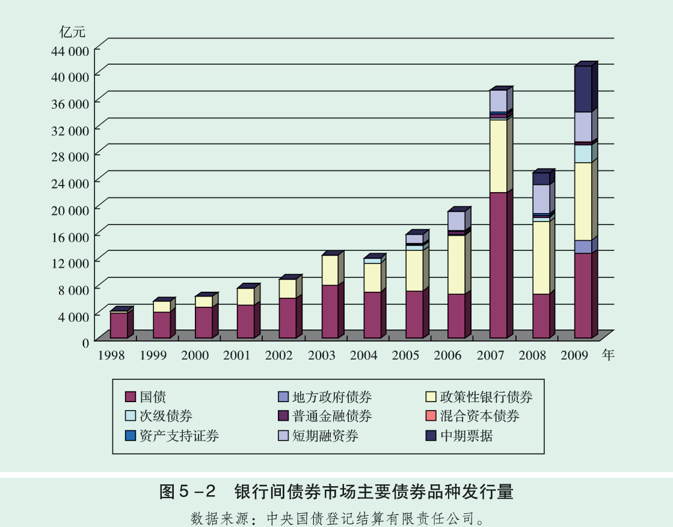
China Bond Market

Slide 14
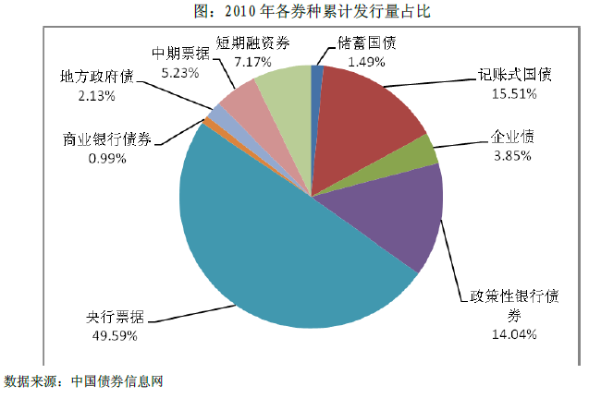
China Bond Market Structure

Slide 15
US Bond Market

Slide 16
US Bond Market Structure

Slide 17
Asset-Backed Securities
Asset Securitization Basic Structure
Assets create
Assets Sold
ABS
Originator
Issuer/
Service Institution
Special Purpose Vehicle
Investor
Credit/Insurance

Slide 18
Asset-backed Securities
Type of Asset-backed Securities
Home Equity Loans
Autos
Credit Cards
Credit Enhancement:
Excess Spread
Over Collateralization
Reserve Account
Surety Bonds
Wrapped Securities
Letter of Credit
Cash Collateral Account

Slide 19
Mortgage Backed Securities
Key Associations
Government National Mortgage Association (GNMA) backed by the National Housing Act 1970 – Ginnie Mac
Federal National Mortgage Association (FNMA) - Fannie Mae (房利美)
Federal Home Loan Mortgage Corporation (FHLMC) – Freddie Mac (房地美)
Type of MBS
Pass-through securities
Collateralized Mortgage Obligations(CMO)
Commercial Mortgage-backed Securities (CMBS)
Collateralized Debt obligation (CDO)

Slide 20
Foreign Exchange Market
Foreign Exchange Market refers to where trading occurs for one currency in terms of another.
No physical market or central exchange floor
Open twenty-four hours a day, except for short gaps on weekends.
the market is traded “over-the-counter” (OTC) by a global network of trading desks at large, international banks that transact with each other electronically.

Slide 21
Foreign Exchange Market
Spot Market
A market for the immediate purchase and delivery of currencies.
Spot Exchange Rates
Market prices of foreign exchanges in the spot market
Forward Exchange Market
A market for contracts that ensures the future delivery of and payment for a foreign currency at a specified exchange rate.
Forward Exchange Rates
The prices of contracts traded in the forward exchange market.

Slide 22
Foreign Exchange Trading
Direct Quote
Quote in term of the home currency with the foreign as the base.
For Example: In Japan, the value of Yen could be express as USD/JPY. In US, it will be JPY/USD.
Indirect Quote
quoting in foreign terms with the domestic as the base.
For Example: In Japan, it will be JPY/USD.

Slide 23
Foreign Exchange Trading
Two way Quote: Bid and Offer
Bid is a price at which bank are willing to buy for the base currency.
Offer is a price at which bank are willing to sell for the base currency.
For example:
EUR/USD 1.4710/1.4712
The bid is 1.4710. The bank will buy euros for $1.4710 U.S. dollars.
The offer is 1.4712. The bank will sell euros for $1.4712 U.S. dollars.

Slide 24
Foreign Exchange Forward
Transaction involving the exchange of two currencies at a rate agreed on the date of the contract for value or delivery at some time in the future (more than two business days later)
Quote as Forward Point
For Example:
EUR/USD Bid Ask
SP 09/10/08 1.4133 / 1.4135
1M 10/10/08 -22.91 / - 22.61

Slide 25
Foreign Exchange Forward
Forward rate = Spot +/- Forward Points
the rate for the 1 month
Bid: 1.4133 - .002291 = 1.411009
Offer: 1.4135 - .002261 = 1.411239
The dealer will buy (you can sell) 1 euros for 1.411009 USD
The dealer will sell (you can buy)1 euros for 1.411239 USD, for delivery in one month’s time.

Slide 26
Investment Companies
Open-End Funds: refer to as mutual fund
Continually sell new shares and redeem outstanding shares
Share price based on NET ASSET VALUE per share
Load fund ,no-load fund and back-end load fund
Close-End Funds: sell shares like any other corporation but usually do not redeem the shares.

Slide 27
Investment Companies
Close-End Funds:
The price of share is determined by supply and demand.
Trading at a discount
Unit Trusts
Typically invest in bond
No active trading of the bonds in the portfolio of the Unit Trusts
Have a fixed termination date

Slide 28
Investment Companies
Funds of Funds(FOFs)
FOFs are mutual funds that hold and invest in shares of other mutual funds.
Hedge Funds
A private investment fund that charges a performance fee and is typically open to only a limited range of qualified investors.
Because of an exemption from the types of regulation, hedge fund can invest in more complex and riskier investments than a public fund.

Slide 29
The structure of Mutual fund

Slide 30
Market for Derivative Securities
Futures Contract
Futures Markets
Commodity Futures
Financial Futures
Stock Index futures
Interest Rate futures
Currency futures
Margin Requirements
Futures versus forward contract

Slide 31
Derivative Securities
Options Contract
Call and put option
European and American option
Risk and Return Characteristics of Options
Option Markets
Swap
Interest Rate Swap
Currency Swap
Risk and Return Characteristics

